Slide 1
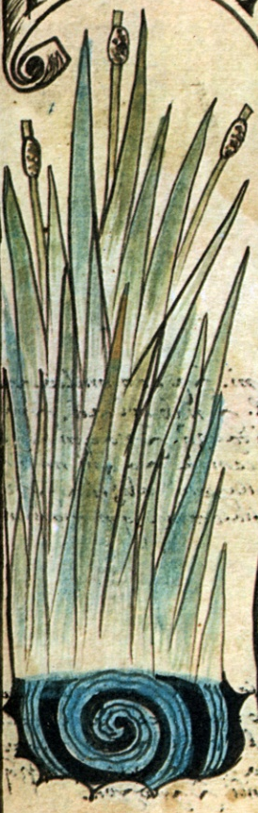
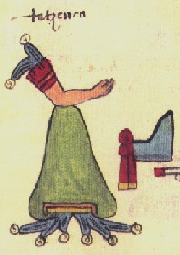
From mountains to cattails:
Strategies of Governance in Ancient Mesoamerica
Thomas G. Garrison
Brown University
Notes:
Thanks – Search committee, Sue, Bill Simmons, Cathy Lutz, faculty, postdocs and students, Steve
Not talking GIS or El Zotz
How governance functioned in ancient Mesoamerica
Why did some polities have a broader influence than others?
Why were different political decisions made?
After some background information, I would like to define two principle strategies of governance in Mesoamerica
Case studies
Argue that the origins of these strategies date to the earliest Mesoamerican civilization and should be considered defining characteristics of Mesoamerican states

Slide 2
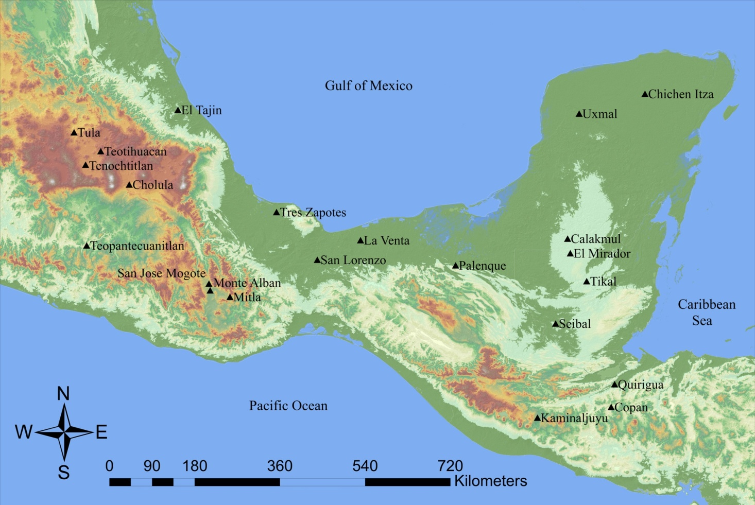
Major Cultures of Mesoamerica
Olmec (1000-400 BCE)
Zapotec (400 BCE-800 CE)
Classic Maya (250-850 CE)
Teotihuacan (100-550/600 CE)
Toltecs (950-1150 CE)
Aztec Empire (1375-1521 CE)
Notes:
Zapotec succeeded by Mixtec city-states
Final three had huge influence, but their capitals were located in the central Mexican highlands

Slide 3
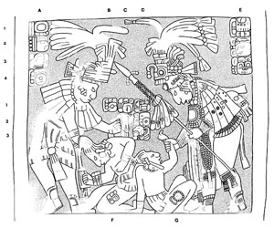
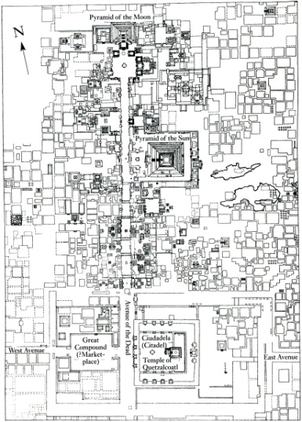
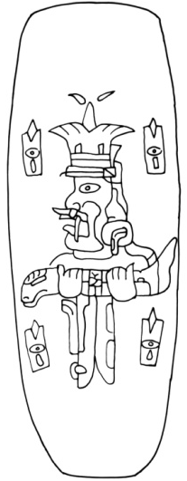
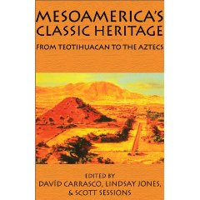
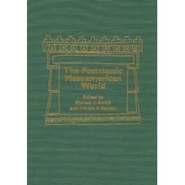
Investigating Mesoamerica
Maya Warfare
Teotihuacan Urbanism
Olmec Iconography
Notes:
Trend to focus on an individual culture and present some sort of analysis specific to that group
Broader studies focus on specific time periods

Slide 4
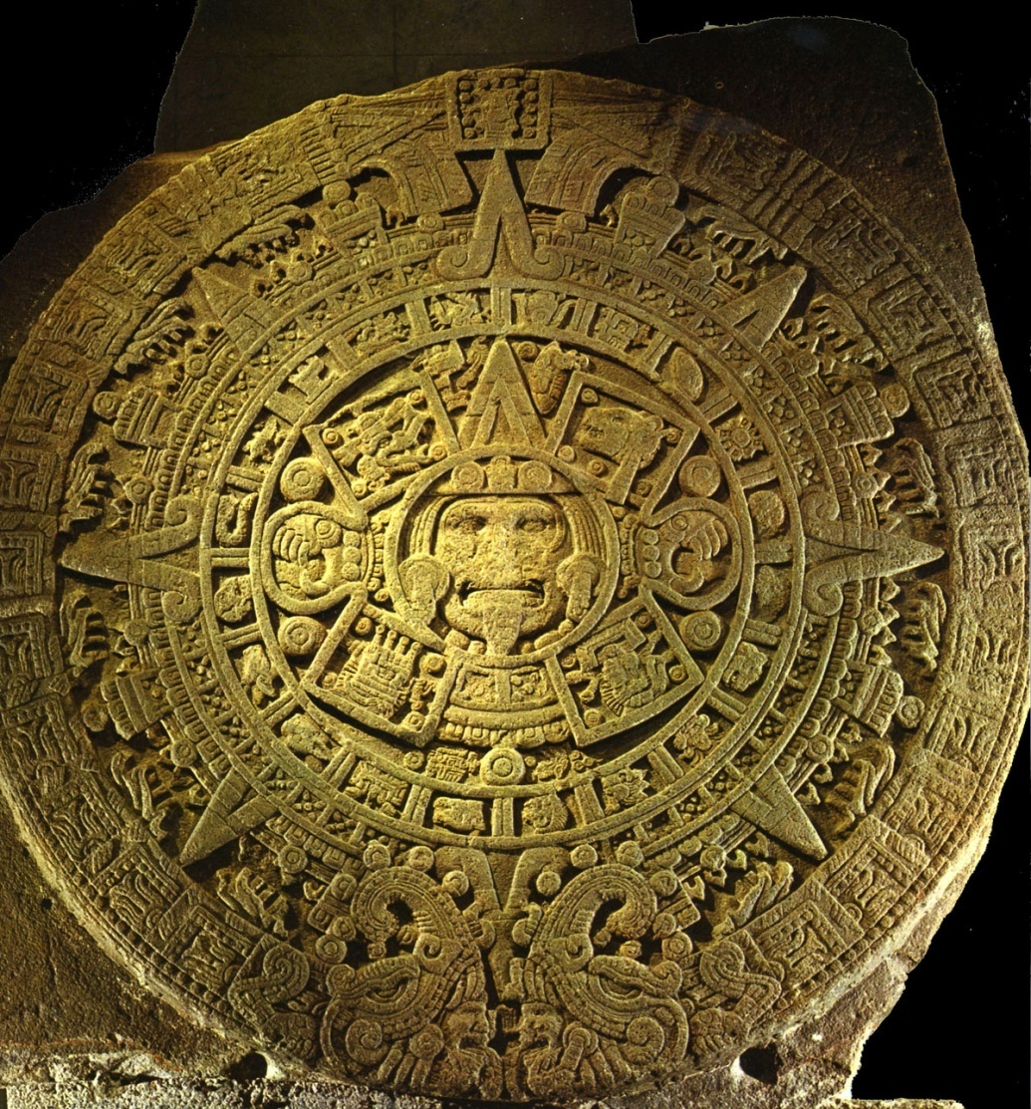
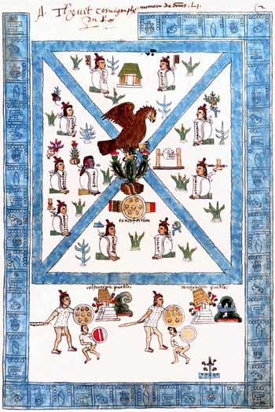
Mesoamerican Cosmovision
Aztec Sun Stone
Frontispiece of the Codex Mendoza (Aztec)
Notes:
Carrasco and Lopez Austin have done broad comparative work using the framework of cosmovision
Worldview with a nexus – shared set of core beliefs found in all Mesoamerican civilizations

Slide 5
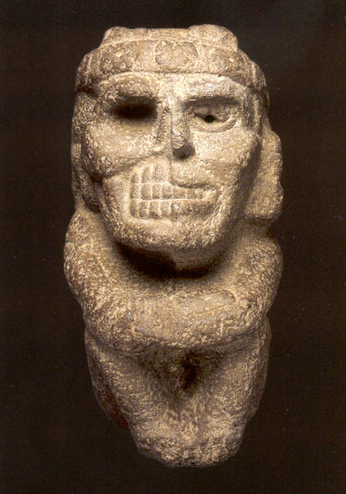
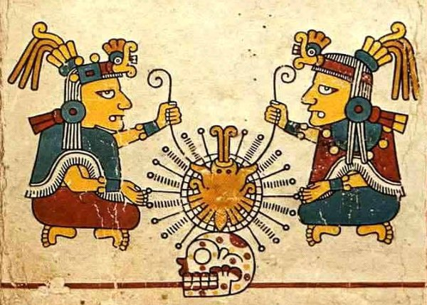
Duality
Ometeotl – Aztec Creator God
Aztec sculpture
Notes:
Ometeotl (heart of heaven, gucumatz for the Maya)

Slide 6
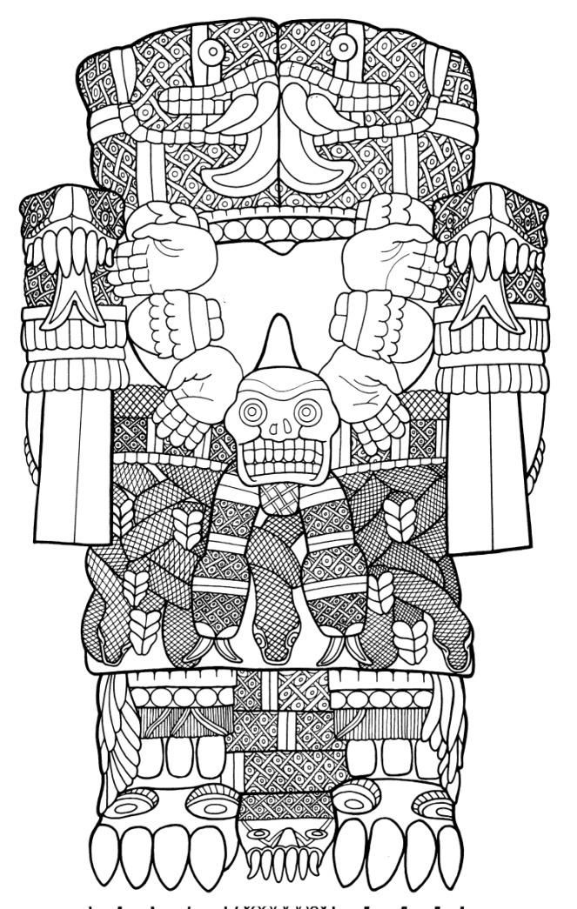
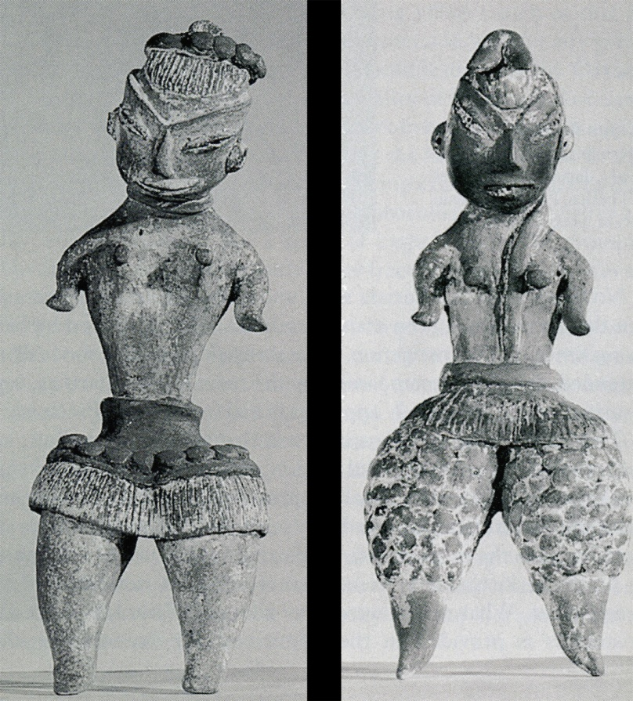
Fecund Mother Earth
Female figurines (Formative Central Mexico)
Coatlicue – Aztec “Mother of Gods”

Slide 7
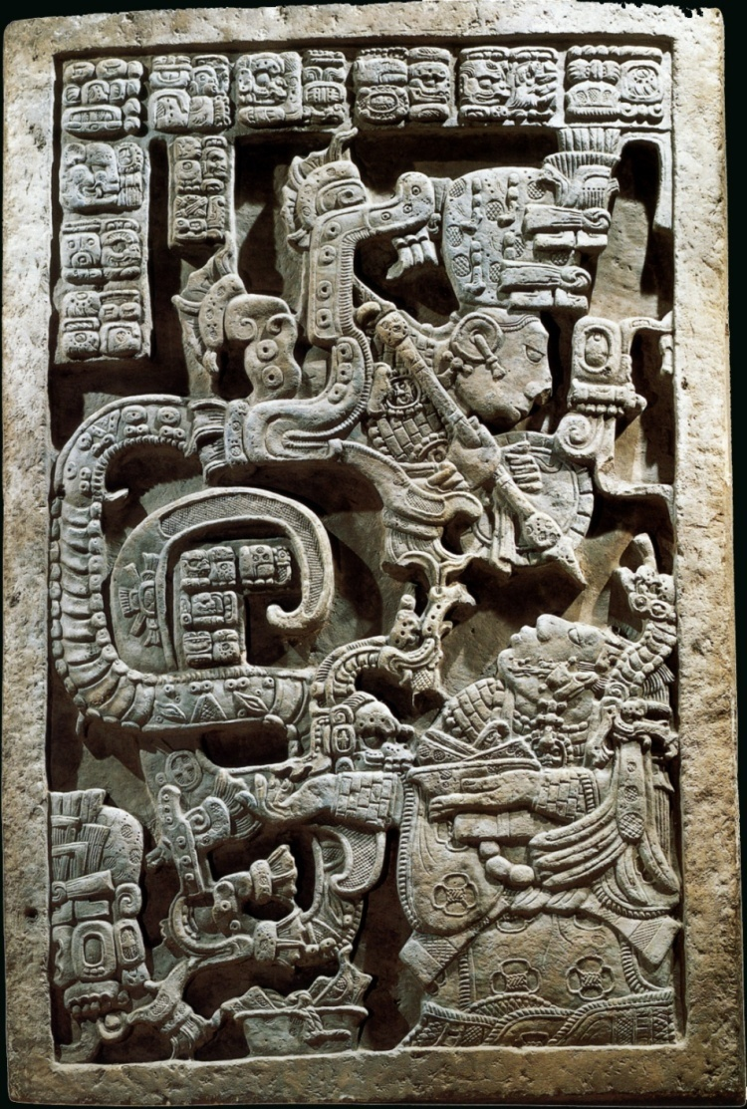
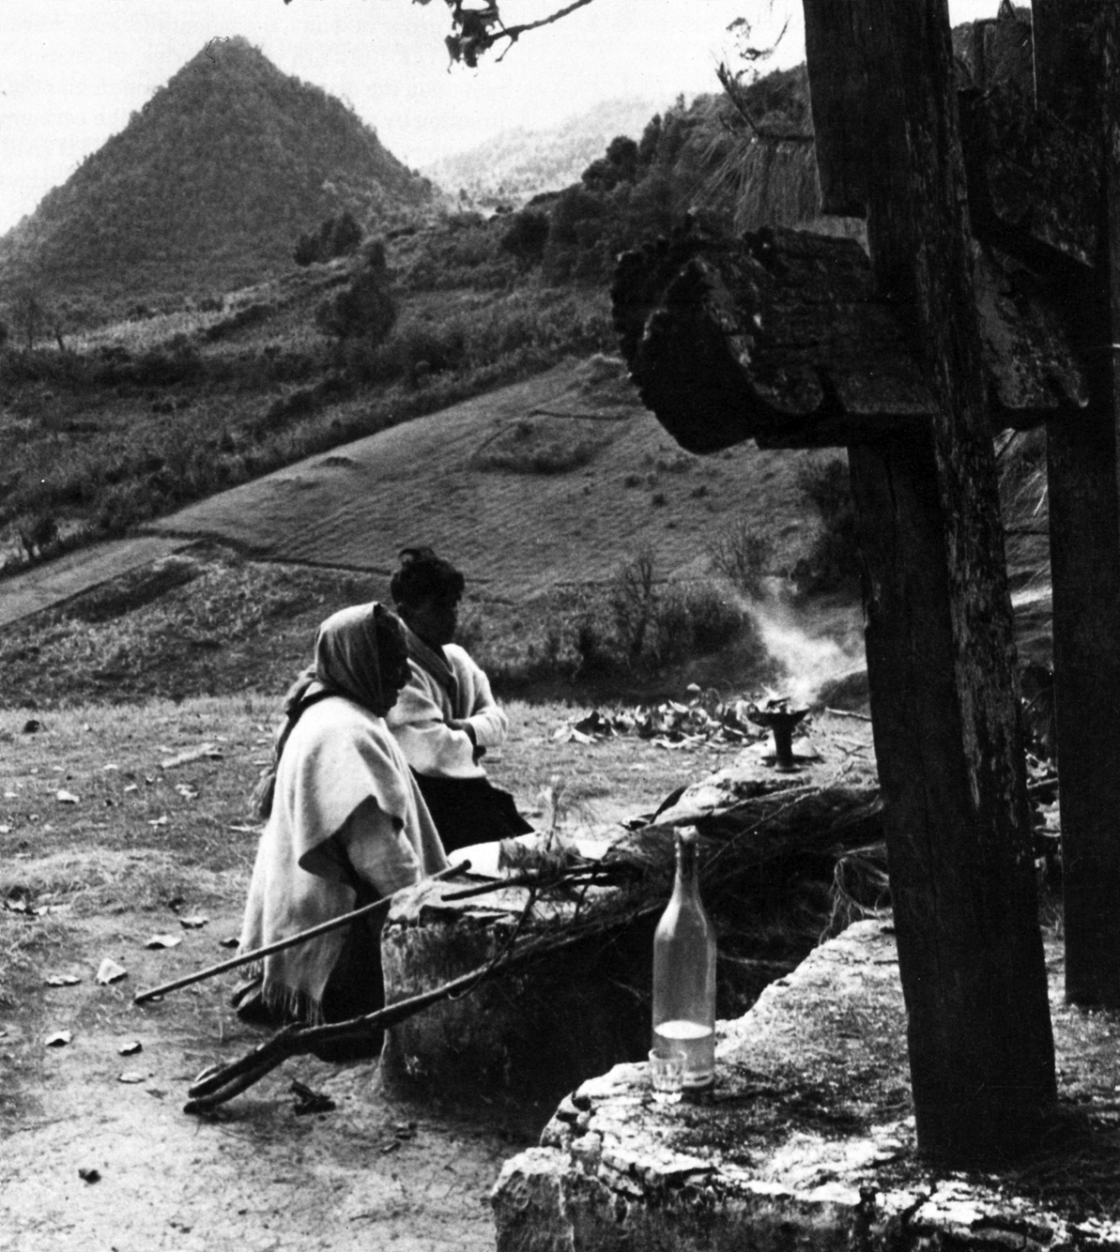
Communication with Supernaturals and Ancestors
Yaxchilan, Lintel 25 (Classic Maya)
Modern Maya, Zinacantan, Chiapas

Slide 8
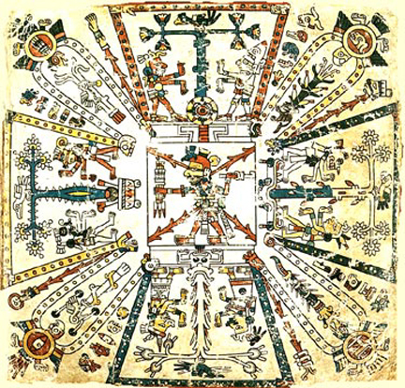
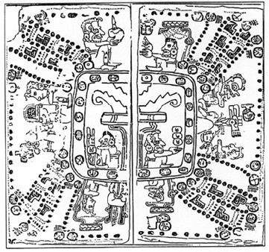
Four Quarters and the Center
Codex Fejérváry-Mayer – Aztec
Madrid Codex - Maya

Slide 9
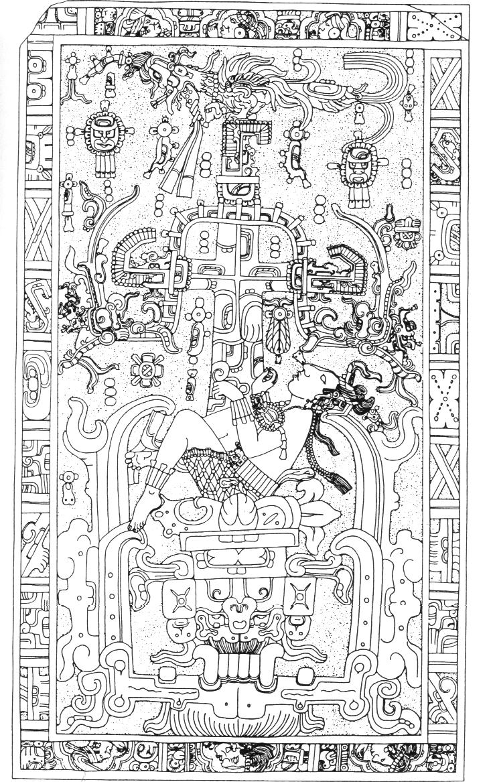
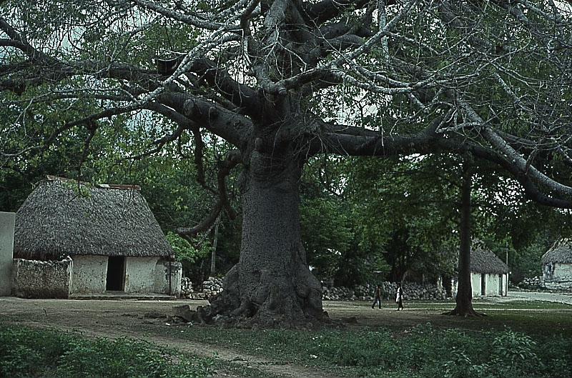
Axis Mundi
Modern Maya village center, Yucatan
Pakal’s Sarcophagus, Palenque (Classic Maya)

Slide 10
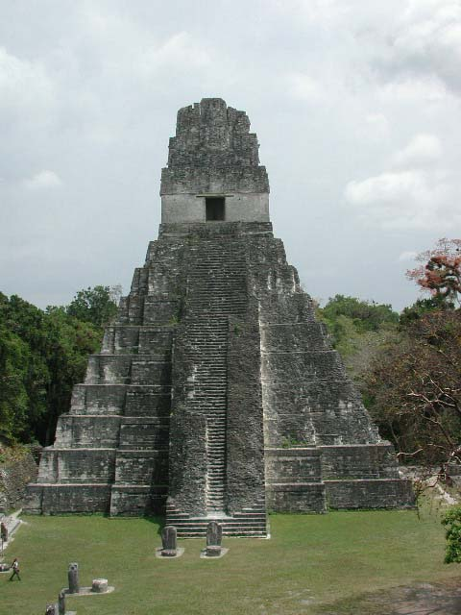
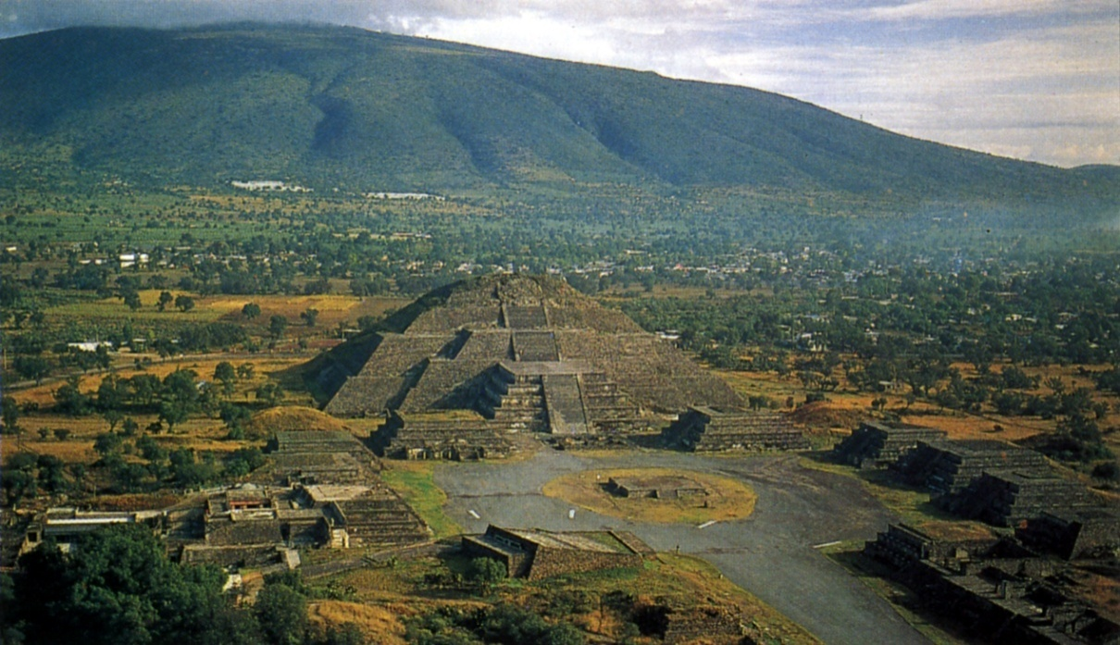
Sacred Mountains
Pyramid of the Moon, Teotihuacan
Temple 1, Tikal (Classic Maya)
Notes:
Cosmovision is a useful framework, but has a strong cosmological and religious focus
The core beliefs that have been identified are only those that survive to the present
Political strategies in ancient Mesoamerica were closely connected to religious and cosmological concepts, but since governance was taken out of the hands of native people after the Spanish Conquest there in no modern day survival

Slide 11

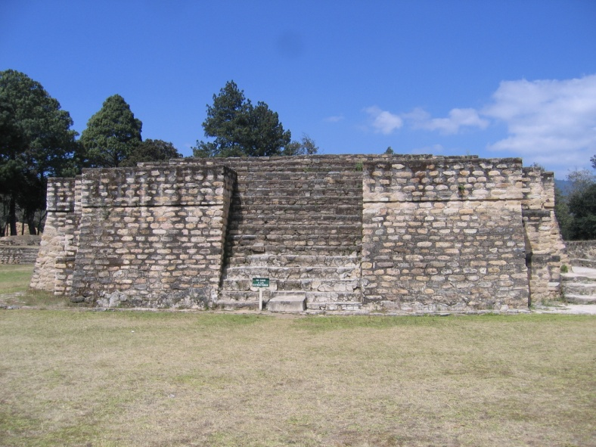
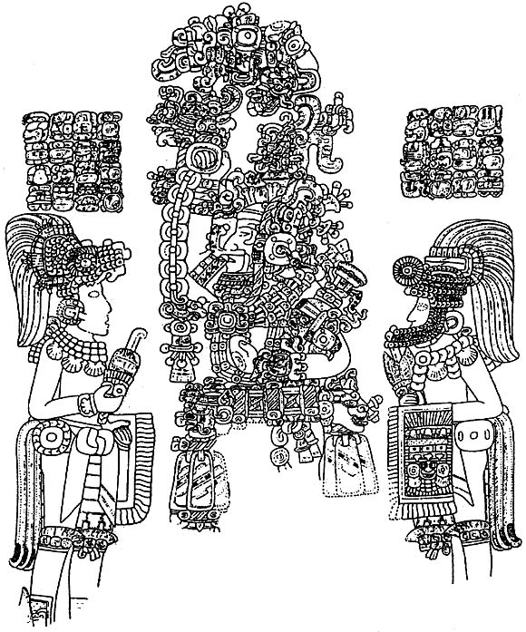
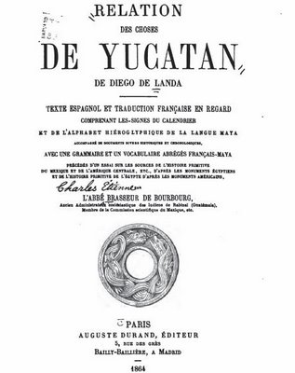
Studying Strategies of Governance
Archaeological evidence
Epigraphic/iconographic evidence
Ethnohistoric evidence
Notes:
Diverse data, conjunctive approach, holistic interpretation
Archaeological – regionally diagnostic artifacts, architecture = spread of economic, but also political influence; settlement patterns = structure of system
Epigraphy/iconography – Maya texts = political units, individuals, interactions; iconography = protagonists and antagonists, spread of stylistic influence
Ethnohistory – particularly Nahua = broad documentary record from contact and colonial periods provides info on political interactions and strategies of governance

Slide 12
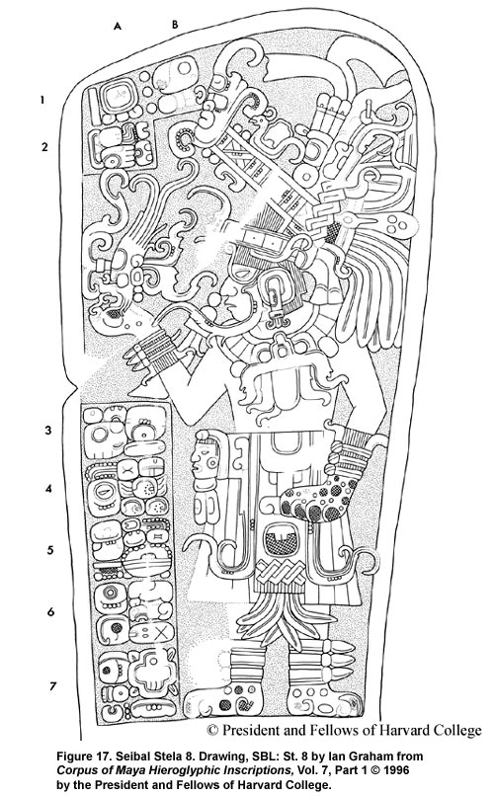
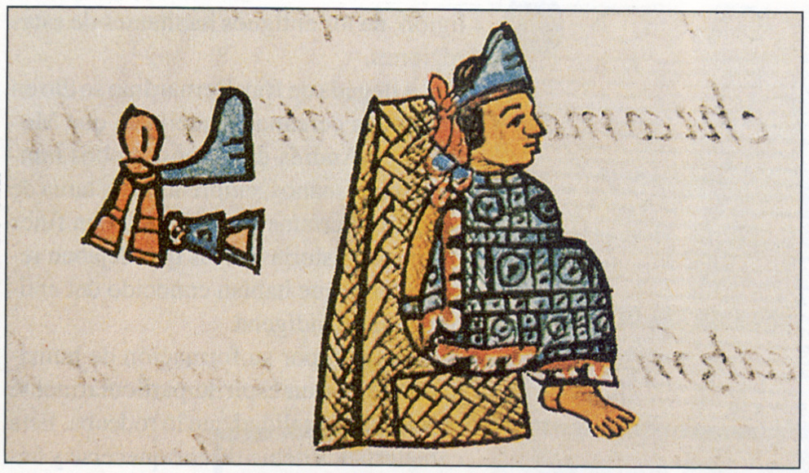
The Dynastic Ruler
Motecuhzoma II, Florentine Codex (Aztec)
Seibal, Stela 8 (Classic Maya)
Notes:
Political structure revolved around the dynastic ruler
Hereditary rule passed down in royal lineages, generally through the male line (but not always)
Maintaining loyalty of royal court was crucial

Slide 13
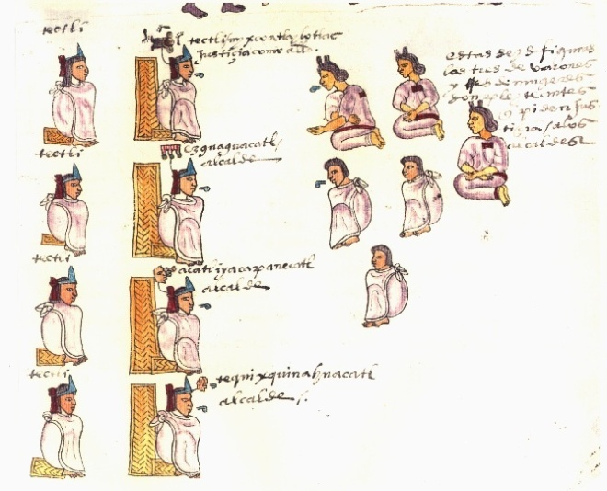
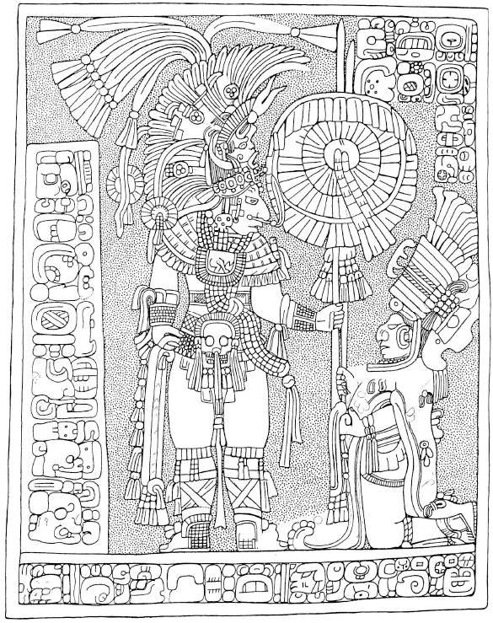
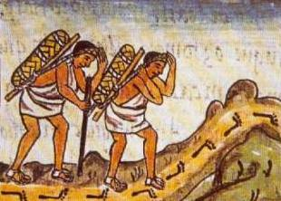
Non-Royal Elites
Aztec judges, Florentine Codex
Site R, Lintel 3 (Classic Maya)
Pochteca, Florentine Codex
Notes:
Non-royal elites are prevalent throughout Mesoamerican state iconography
Sajal, Aztec judges
Merchant class controlled political economy – precious materials necessary for rituals (jade, obsidian, exotic feathers, marine shells, etc.)
Pochteca class had to sneak into Tenochtitlan at night
Craft specialists like carvers and scribes also important

Slide 14
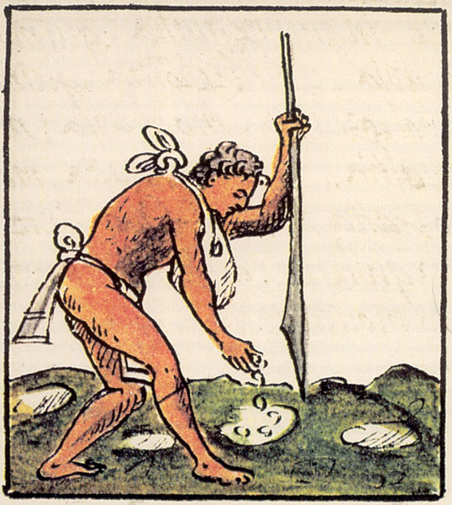
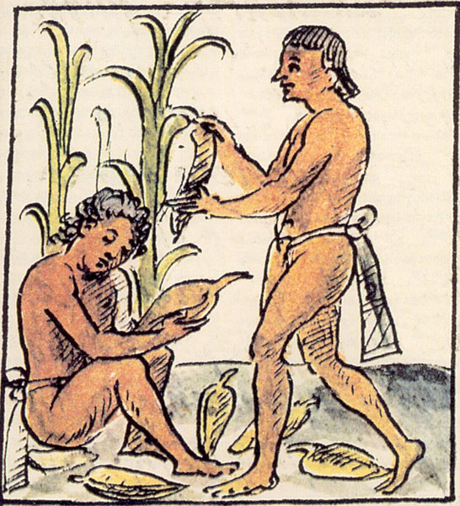
Peasant Class
Macehuales, Florentine Codex
Notes:
Majority of Mesoamericans – provided agricultural surplus for the court
Tied to capitals through enforced tribute as well as participation in public rituals in large plazas of Mesoamerican sites
Rituals would be tied to the sacred calendar as well as supernatural forces influencing agricultural productivity
Reinforced peasants dependence on the court for spiritual and economic survival

Slide 15
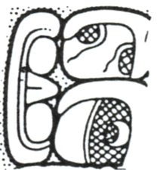
Strategies of Governance
Local strategy
Expansionistic Strategy
Stable
Geographically defined territory
Tribute obtained from local hinterland
Local conflicts
Political unit defined as a metaphorical couplet (altepetl; kab-ch’e’n; yuhuitayu)
Wealthy
Extensive political/economic network
Tribute obtained from provinces
Expansionistic conflicts
Political unit defined by urban center’s association with tollan (“Place of Cattails”)
altepetl
u-kab-ch’e’n
Notes:
Generally employed one of two strategies of governance, that would condition how the polity interacted with other states during the ruler’s reign
Local strategy – Go through list; Rulers often portrayed as source of political power in monuments and codices
Valued luxury goods obtained through exchange rather than tribute
Stability = smooth succession in the royal line compromise on luxury goods
Expansionistic – Aztec, Tula, Teo (Tikal and Monte Alban nested in Teo program)
Expand tributary base beyond the local level (increase quantity and diversity); spread influence by claiming to be source of political authority (tollan)

Slide 16

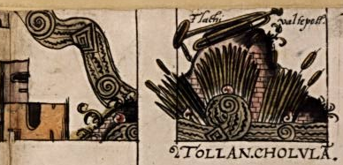
Tollan – “Place of Cattails”
Notes:
Tollan is often prefixed to major Postclassic city names – meaning “Place of Cattails”
Maya glyph - pu
Quilatinizoo – Lagoon of primordial blood as a conceptually analogous Mixtec term
The concept of tollan connects the city to mythological sources of power and rulership
Rulers from external polities would then use the symbol of that city to justify their own local power

Slide 17
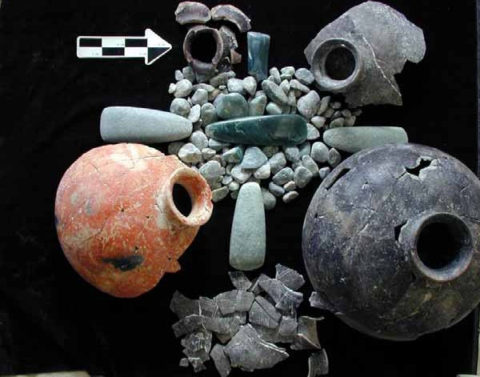
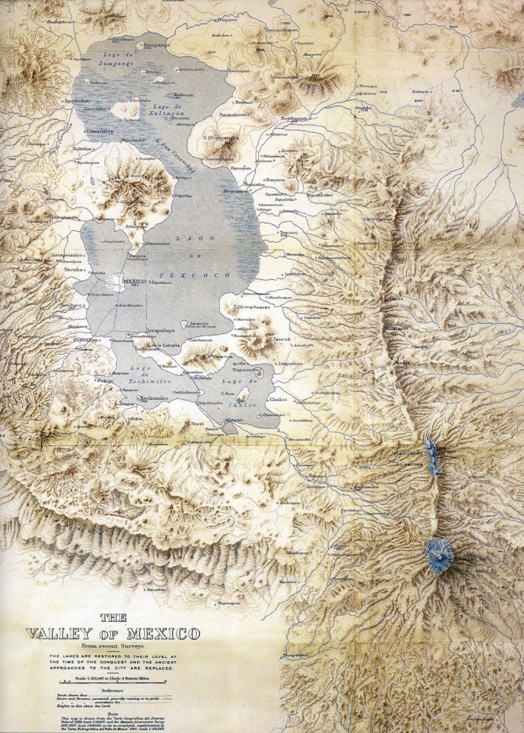
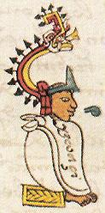
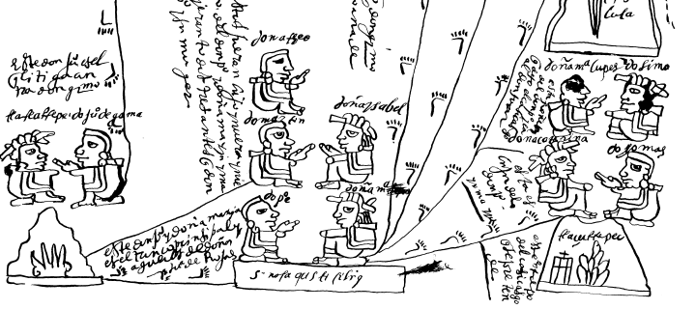
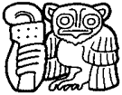
Factors Influencing Strategies
Individual Agency
Geographic Circumscription
Stability vs. Wealth
Wealth – Maya jade (Holmul)
Itzcoatl
Spearthrower Owl
Stability – Mixtec Genealogy of Tlazultepec
Notes:
Agency – Itzcoatle, Motecuhzoma I, and Ahuitzotl were major expanders; Spearthrower Owl
Geographic circumscription – degree of political isolation locally; mountains as dividers; islands as isolating geography; failures of Maya and Epiclassic Expansionistic strategies
Compromise of stability vs. wealth – luxury items as tribute rather than exchange – creates political instability; Teo destroyed; Spanish Conquest

Slide 18
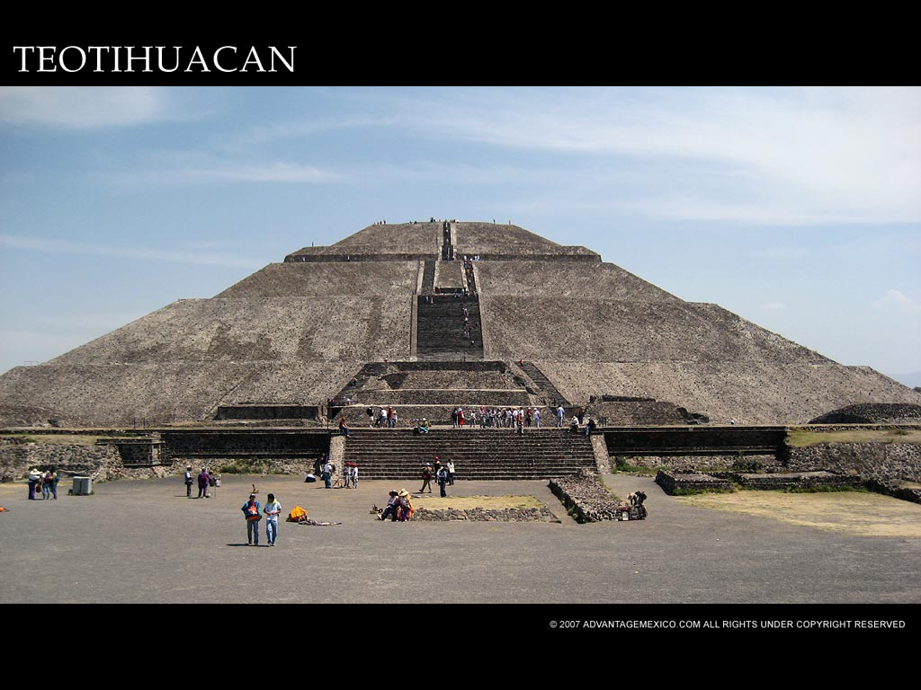
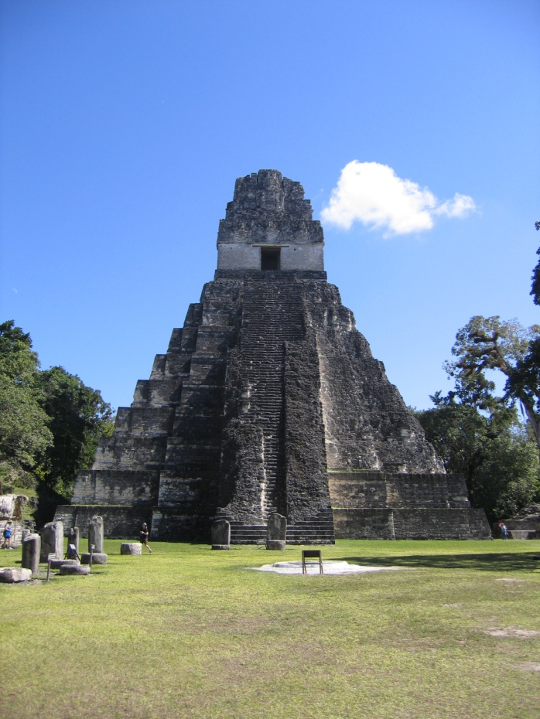

Three Case Studies
Late Formative Central Mexico and Teotihuacan
The Maya and Early Classic Tikal
The Aztec Empire
Notes:
Case studies exhibiting how these strategies of governance came into play in different places and at different time periods

Slide 19
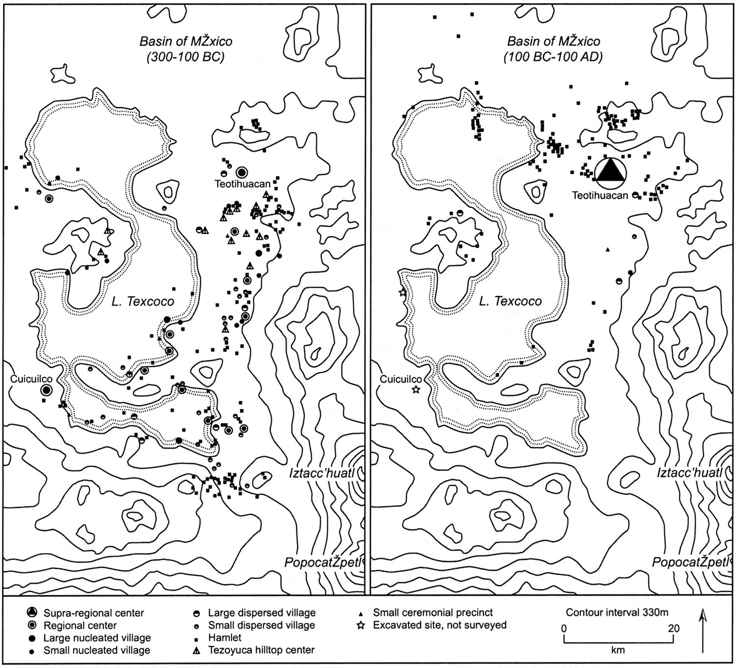
Late Formative Central Mexico and Teotihuacan
Patlachique
Phase
Tzacualli
Phase
(150-1 BCE)
(1-150 CE)
Notes:
One of best understood regions – Bill Sanders
Patlachique (150-1 BCE) and Tzacualli (1-150 CE)
Change during phases from competing local formative states to Teotihuacan as a supra-regional center
Two major volcanic eruptions appear to have contributed to this

Slide 20
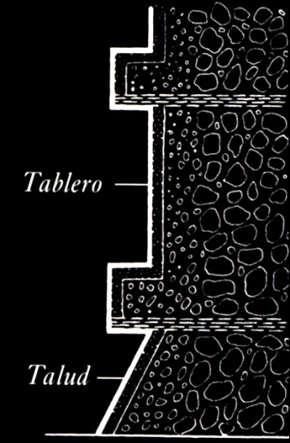
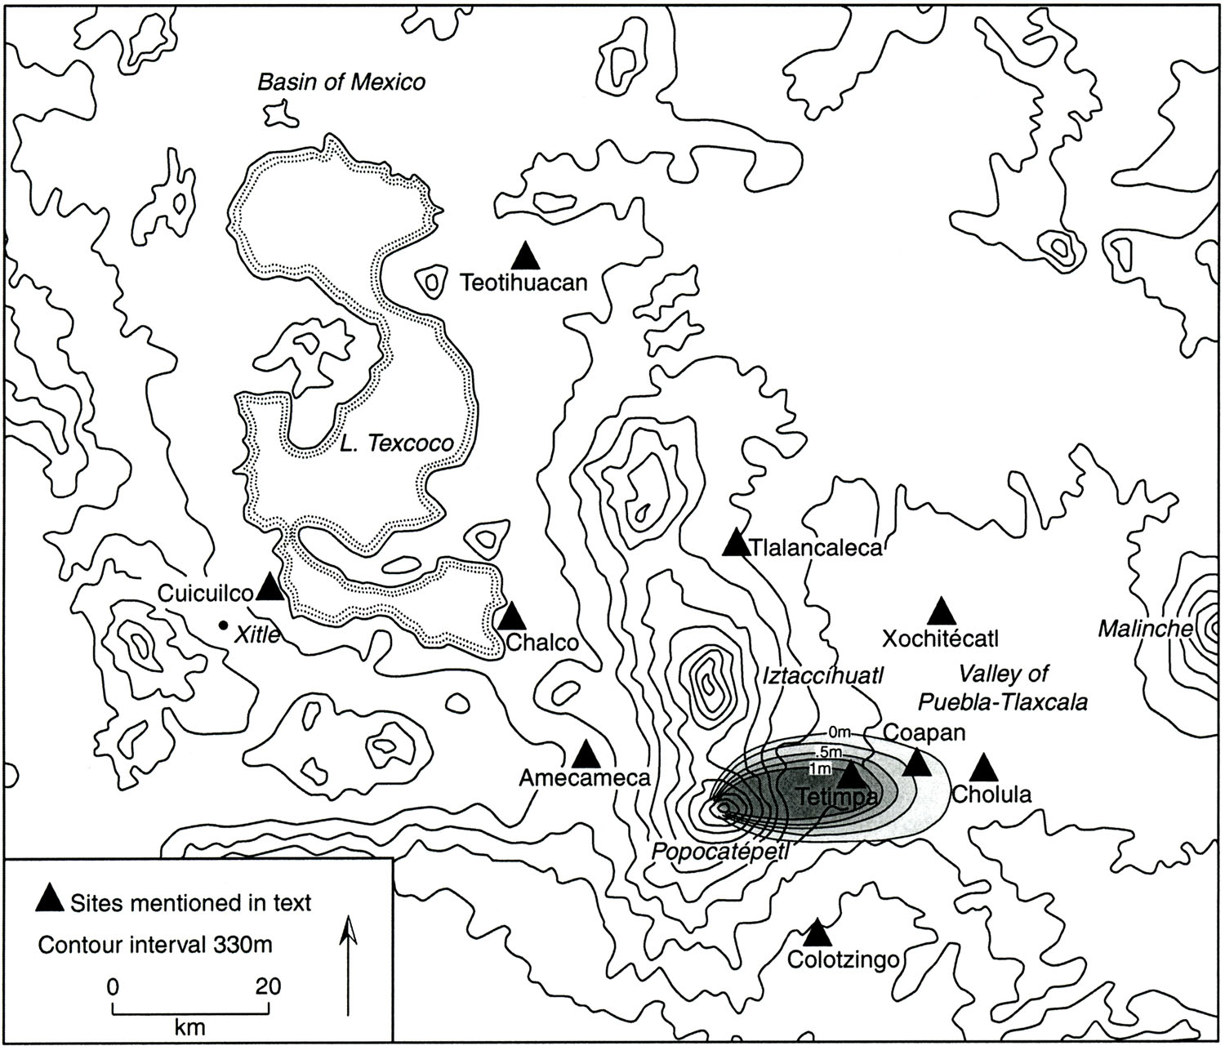
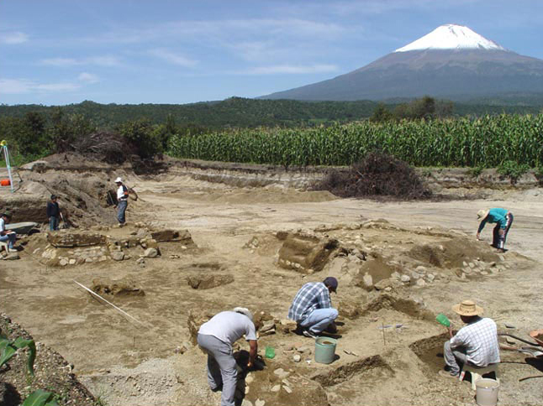
Popocatepetl Eruption
Notes:
Plinean eruption 100 CE led to massive population reorganization in the P-T Valley
Tetimpa – talud-tablero architecture (Teo signature) predates appearance at Teo (possible population movement)
Abandonment of sites in the P-T Valley (Cuahtinchan) and nucleation at Cholula

Slide 21
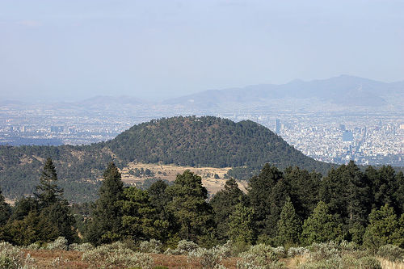
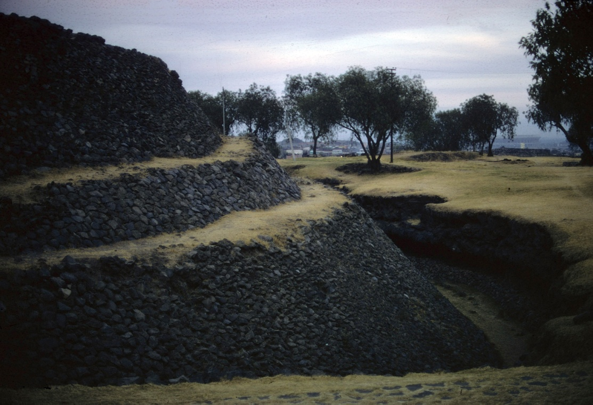
Xitle Eruption
Buried Cuicuilco Pyramid
Xitle’s Dome near Mexico City
Notes:
Once thought to have been in the 1st century BCE – now it seems it may have occurred anywhere from 200-300 years later
The Xitle volcano overlooks Cuicuilco in the SW Basin of Mexico and the eruption coincides with the abandonment of that site, leaving Teotihuacan as the dominant settlement in the basin

Slide 22
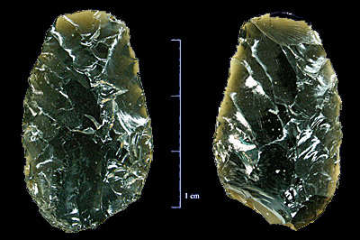

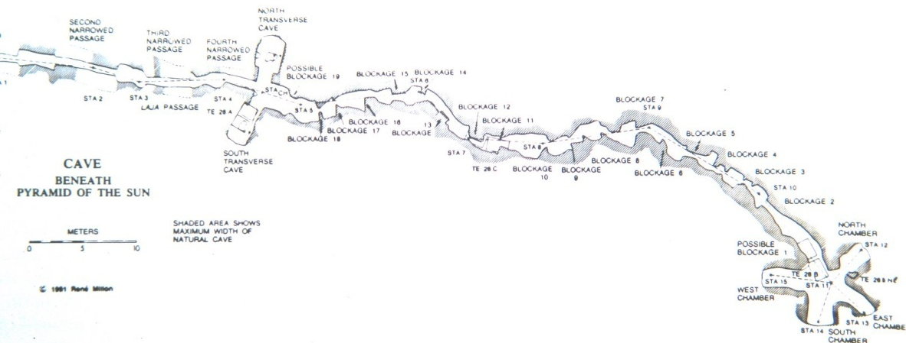
Teotihuacan’s Local Strategy
Notes:
Rulers (never depicted) consolidated local resources (Pachuca obsidian, hydrological modification of San Jose River)
Ideological consolidation (P. of Moon and Cerro Gordo; P. of Sun and cave beneath)

Slide 23
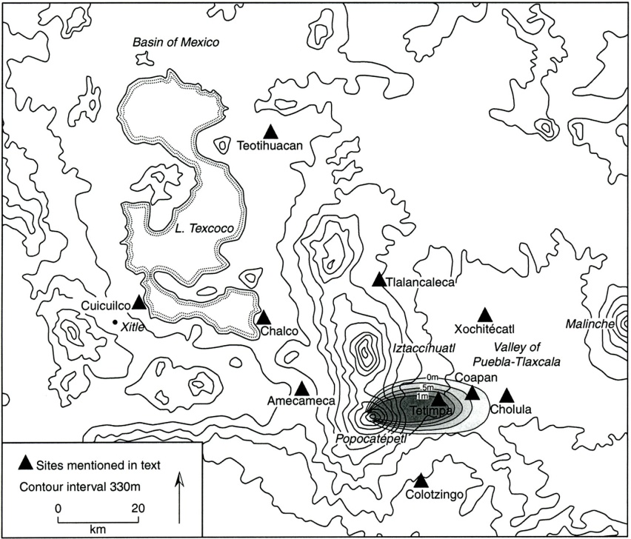

Teotihuacan’s Expansionistic Strategy
Geographic circumscription separated Teotihuacan from the Puebla-Tlaxcala Valley
Spearthrower Owl emerged as a charismatic visionary leader
The city grew as an economic power at the expense of its political stability
Spearthrower Owl
(374-439 CE)
Notes:
During the late 4th century Teo switches to an Expansionistic strategy
Separated from Cholula
Spearthrower Owl emerges as major leader (reigns 374-439 CE)
Accumulation of luxury resources from an enormous area covering most of Mesoamerica (destroyed 550-600 CE after ~200 yrs)

Slide 24





Teotihuacan’s External Influence
Tikal, Guatemala
Monte Alban, Oaxaca
Notes:
Influence seen by iconographic references to the Teo style
The city represented the ideal of power rather than any specific ruler
Lapida de Bazan and Hidden Scenes at Monte Alban
Teo’s influence in the Maya area bring me to the next case study

Slide 25



The Early Classic Maya and Tikal
Sites suffering Late Preclassic abandonments
Major Early Classic Centers (in red)
El Mirador, Guatemala
Notes:
Causes of LPC abandonments still debated but probably a combo of mismanagement of the agricultural landscape in combination with climatic factors (probably a long drought)
Surviving population nucleated at select centers – Tikal, Caracol, Holmul, Xultun, and Rio Azul

Slide 26



Tikal’s Local Strategy
Water Management at Tikal
Chan-kab-ch’e’n
Stela 29, 292 CE
Notes:
Survived due to sophisticated water management, innovative intensive agriculture, and lower Preclassic populations (resources not exhausted)
Tikal in particular was strategically located on a large piece of elevated land bridging the drainages
Epigraphers estimate that a powerful dynasty began in the 1st century CE and grew more powerful in the Early Classic (stelae) – local
In Maya inscription the polity was referred to a kab-chen or chan-kab-chen linking the Local Strategy of governance to the natural world and Maya cosmology

Slide 27


The “Arrival of Strangers”
Yax Nuun Ayiin I
Notes:
Long distance trade was common in the Formative (Chicanel sherds at Teo; central Mexican artifacts at Tikal)
Jan 15 378 CE – relationship changed drastically
Sihyaj K’ahk’ (Born from Fire) arrives and on the same day Chak Tok Ich’aak I “enters the water”
Within a year a new ruler is placed on the Tikal throne and he is named as Spearthrower Owl’s son

Slide 28



Tikal’s Expansionistic Strategy?
Notes:
Over the next decades, in part with assistance from Sihyaj K’ahk’, Tikal expanded its influence in the Maya lowlands
Appears like the Expansionistic Strategy was introduced to the Maya lowlands
Allies at: Caracol, Holmul, Yaxha, Xultun, Copan, Palenque, Rio Azul
From a geographic standpoint these alliances appear to have been motivated by economic consolidation
Copan; Caracol; Xultun, Rio Azul, Holmul; Palenque
I argue that Teo established a ruler at Tikal to consolidate lowland tropical resources as part of its own Expansion

Slide 29


Why not Tikal?
Yax Nuun Ahiin was not a charismatic ruler
Tikal was not geographically circumscribed
Tikal was not referenced as a tollan
Calakmul, Campeche
Tikal, Temple 1, Linel 2
Notes:
Yax Nuun Ahiin was not from the local dynasty – limiting his accomplishments without assistance from Teo
Tikal was not sufficiently isolated from its neighbors – loose economic alliance was systematically broken up by Calakmul in the 6th century (conquer Tikal in 562 CE)
Other Maya sites did not reference Tikal as a tollan – or as a source of power; yes Tikal rulers were sometimes asked to oversee accessions, but all references to tollan include central Mexican/Teo iconography – references to local lords continued
Conclude that the Maya never had a truly Expansionistic Strategy of governance

Slide 30




Tula and Cholula
Tovar Codex
Historia Tolteca-Chichimeca
Tula, Hidalgo
Cholula, Puebla
Notes:
The very concept of tollan comes from our understanding of the Postclassic
I am skipping over important places like Tula and Cholula that claimed to be Tollans at different periods and turning instead to the Aztecs
Mixtec city-states claimed power from Cholula
Nahua city-states claimed power from Tula

Slide 31

Nahua City-States and the Aztec Empire
Toltecs at Colhuacan and Xico
  End of 12th century
Acolhua at Coatlinchan
  AD 1160
Tepanecs at Atzcapotzalco
  AD 1230
Xolotl and the Chichimeca at Tenayuca
  AD 1244
Otomi at Xaltocan
  AD 1250
Notes:
Nahua considered the Toltec city of Tula to be the archetypical Tollan
Teotihuacan was considered to be a Tollan of the gods – was the setting of the creation myth of the Fifth Sun where the current world was created
By the mid-12th century there were a number of Nahua city-states using Local Strategies

Slide 32

Arrival of the Aztecs
Notes:
Aztecs were late arrivals, probably not coming to the Basin until the early 14th century
Worked as serfs and mercenaries until they were eventually able to establish there own city of Tenochtitlan on an island in Lake Texcoco

Slide 33


The Aztec’s Local Strategy
Acamapichtli – First Aztec tlatoani
Coatlichan
Notes:
The creation of Tenochtitlan meant that the Aztecs had their own altepetl (water mountain – talk title)
Coatlichan – Acolhua – House of Snakes
Altepetl is analogous to the Toncatepetl (Mountain of Sustenance) from which the gods took maize to give to humans
-Local power connected to agriculture
Under patronage of Tezozomoc of the Tepance Nahua, the Aztecs received their first tlatoani in 1375 CE

Slide 34


How does an altepetl become a tollan?
Tlacaelel, Codex Azcatitlan
Itzcoatl’s Conquests, Codex Mendoza
Notes:
Aztecs are an interesting case study because of detailed documentary record
Itzcoatl (4th tlatoani) “obsidian snake”
-1428 rose up against the Tepanecs and went on to conquer 23 other local altepetls
Tlacelel (Cardinal Richelieu) advised Itzcoatl to rewrite history
Books gathered and burned – Aztecs claim duel descent from Toltecs and wild Chichimecs to justify their warrior-statesmen approach to politics

Slide 35


The Aztec’s Expansionistic Strategy
Temporal Expansion of the Aztec Empire
Aztec Triple Alliance – Texcoco, Tenochtitlan, Tlacopan
Notes:
Itzcoatl was a transitional reign in terms of strategies of governance – consolidated locally
Imperial expansion began under Motecuhzoma I and Axayacatl (also advised by Tlacaelel)
Appeased local competition by forming the Triple Alliance (Providence, Warwick, and Cranston) under Motecuhzoma
-Allowed broader expansion
Set up tributary and strategic provinces and had a constant stream of goods coming into the market at Tlatelolco

Slide 36


Tenochtitlan as tollan
Aztec talud-tablero at Iximche, Guatemala
Codex Sierra (Aztec)
Notes:
In addition to Mexica claim of direct descent from Toltecs (Codex Sierra tollan), other cultures began to recognize Tenochtitlan as a tollan
Mixtec referred to Tenochtitlan as Nuu Co’yo “Town of Cattails” once Aztec influence spread to Oaxaca in the early 16th century
Spread of the Aztec architectural style to the Guatemalan highlands
-Iximche not part of Aztec Empire but replicated its architecture as a source of power (also round altar)
Representations of Aztec rulers are absent from monumental art of the Postclassic – emphasis on the city

Slide 37


Spanish Conquest
Ruins of the Templo Mayor, Tenochtitlan
Cortes is aided by the Tlaxcalans
Notes:
Major instability as with other Expansionistic polities
War of Flowers – permanent war to justify taking captives from Tlaxcala
-Created political instability exploited by Spanish
Following the siege of Tenochtitlan and the destruction of the Templo Mayor is when the documentary record was created that gives us such detailed information about developing political strategies

Slide 38



Conclusions: Origins of Strategies of Governance in Mesoamerica
Map showing sites consolidated
by San Lorenzo’s Local Strategy
Map of San Lorenzo, Veracruz
Notes:
To conclude I would like to highlight two points – 1. the possible origins of these strategies; 2. what these strategies mean for Mesoamerican studies
I would like to suggest that both strategies date to Mesoamerica’s first civilization - the Olmec
Olmec archaeology is hindered by poor preservation due to time depth and environment, as well as difficulty of site access
From 1400-1000 BCE San Lorenzo emerged as the largest Mesoamerican center – built sacred mountain – consolidated local resources
Rulers depicted as giant heads

Slide 39


La Venta’s Expansionistic Strategy
La Venta, Altar 5, Tabasco
Middle Formative Exchange Systems
Notes:
1000-400 BCE La Venta became the preeminent center
Carving of heads ceased in favor of less individualistic monuments
Developed a massive exchange network bringing in luxury and utilitarian items from all over Mesoamerica
-Same pattern we see for Teo 1000 years later

Slide 40




Olmec Influence in the Middle Formative
Chalcatzingo, Morelos
Juxtlahuaca Cave, Guerrero
Teopantecuanitlan, Guerrero
Notes:
Spread of Olmec icongraphy throughout Mesoamerica
Mother culture?
I would say that La Venta had established itself as the first tollan (may have literally been a place of cattails)
Tempting to think that La Venta was the first to use an Expansionistic Strategy to bring wealth into the emerging state

Slide 41


Conclusions: Mesoamerican States and Strategies of Governance
Tollan (Tula) in the Tovar Codex
Colhuatzinco altepetl
u-kab-ch’e’n
Frieze at Acanceh, Yucatan (with pu highlighted)
Notes:
Finally I will note that the choice of a Local vs. Expansionistic Strategy seems to have been part of the definition of Mesoamerican statehood
Too often we only look comparatively as Mesoamerica as a whole when we are discussing religious concepts that have survived in some altered state to the present day
I hope I have demonstrated that there was a pattern to pan-Mesoamerican strategies of governance and that a comparative perspective can be valuable when investigating broader themes in the archaeology of Mesoamerica

