Slide 1
The Real Buzz: Feasting and Partying in the Homeric Epic
By: Natalie Diehl, Erik Ronning, Kathryn Addonizio

Slide 2
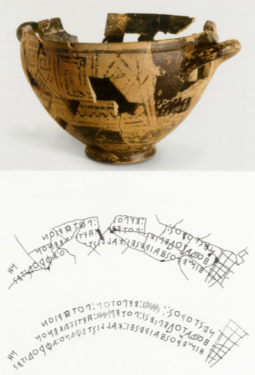
Nestor’s Cup, 735-720
Greek, found in Ischia, Isola d', Napoli, Campania (Italy)
Greek Inscription:
  ΝΕΣΤΟΡΟΣ:...:ΕΥΠΟΤΟΝ :ΠΟΤΕΡΙΟΝ ΗΟΣΔΑΤΟΔΕΠΙΕΣΙ:ΠΟΤΕΡ Ι..:ΗΥΤΙΚΑΚΕΝΟΝ ΗΙΜΕΡΟΣΗΑΙΡΕΣΕΙ:ΚΑΛΛ ΙΣΤΕΦΑΝΟ:ΑΦΡΟΔΙΤΕΣ
Translation of Text from Greek:
  “I am Nestor’s cup, good to drink from. Whoever drinks this cup empty, straightaway Desire for beautiful-crowned Aphrodite will seize him.”
Ceramic with paint

Slide 3
Nestor’s Cup
This clay drinking cup dates back to the Geometric Period, as it was created between 735-720 BC. This drinking cup, also called a kotyle, was discovered in Ischia, Isola d', Napoli, Campania, which had historically been a Greek colony. Nestor’s cup is important because it contains the first epigraphic writing and because it uses the Phoenician inspired Greek alphabet for the first time. Nestor’s cup can be seen at the Villa Arbusto Museum in Lacco Amerno, Ischia.

Slide 4
Nestor’s Cup
Homeric Reference:
  Iliad (11.631-637)
    “…and beside it, a beautifully wrought cup which the old man brought with him from home. It was set with golden nails, the eared handles upon it were four and on either side there were fashioned two doves of gold, feeding, and there were double bases beneath it. Another man with great effort could lift it full from the table, but Nestor, aged as he was, lifted it without strain.”

Slide 5
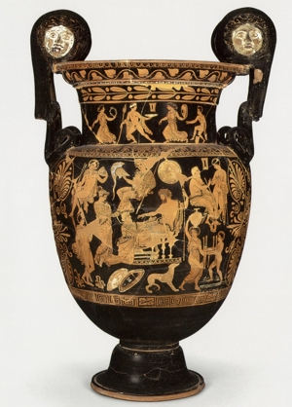
Wine Vessel Depicting Agamemnon with Chryses and Chryseis, 360 BC
Greek; from Taranto, Italy
This Apulian krater depicts Chryses, the priest of Apollo, begging Agamemnon for the return of his daughter, Chryseis.
Ceramics, clay and paint

Slide 6
Wine Vessel Depicting Agamemnon with Chryses and Chryseis
The krater dates back to the Classical Period, as it was created around 360 BC. It depicts a scene from Book I lines 13-37, when Chryses, on his knees before Agamemnon, begs for his daughter’s return. This large drinking vessel, can be seen in the Musée du Louvre in Paris, France.

Slide 7
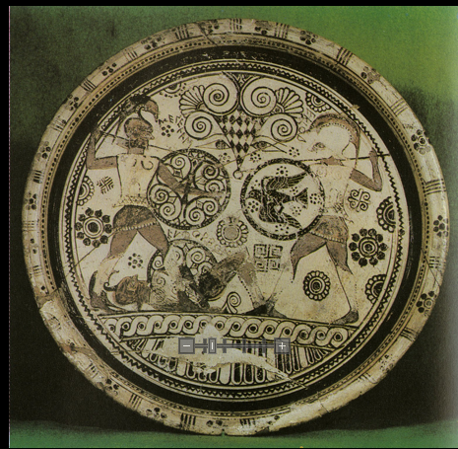
Plate with scene from the Iliad, 625-600 BC
Greek: created in Rhodes, Greece
This plate depicts Hector and Menelaus fighting over the Trojan, Euphorbus, who had been killed in battle
Terracotta, painted

Slide 8
Plate with scene from the Iliad,
This plate was found in Rhodes, Greece, and can be traced back to the Archaic period. This plate depicts the battle between Menelaus and Hector for the body of Euphorbus. These Bronze Age characters are wearing armor that existed in the 7th century, so this plate was designed sometime within the 7th century. This plate can now be found in the London, GRB, British Museum.

Slide 9
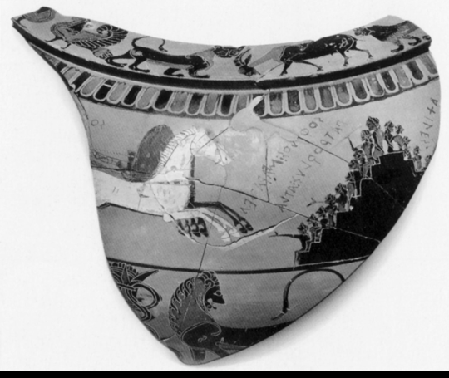
Dinos with Funeral Games for Patroclus, fragment, 580-570 BCE
Greek, Greece painted by Sophilos
Depicts the funerary games of Patroclus in the Iliad
Ceramic; clay, paint

Slide 10
Dinos with Funeral Games for Patroclus, fragment
This shard of pottery depicts the funerary games of Patroclus. It dates back to the Archaic period, as it was created between 580-570 BC. Funerary games relate to feasting in the Greece, as a funerary feast was a part of burial practices. This dinos can now be seen in the National Archaeological Museum in Athens, Greece.

Slide 11
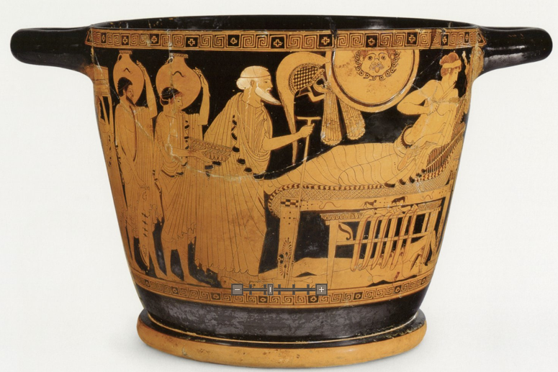
Drinking Cup with Priam pleading with Achilles for the body of Hector, 490-470 BC
Greek; discovered in Athens, Greece
Depicts Priam pleading with Achilles for the body of Hector
Ceramic; clay; paint

Slide 12
Drinking Cup with Priam pleading with Achilles for the body of Hector
This drinking cup was created in the Classical Period by the Brygos Painter in Athens, Greece. Although it was created in Athens, it was discovered in Cerveteri, Italy. It depicts Priam pleading with Achilles for the body of his son, Hector, so that he can give his son a proper burial. This amphora can now be found in the Kunsthistorisches Museum Wien in Vienna, Austria.

Slide 13
QUIZ TIME!
Get the answer correct to get a prize!

Slide 14
Artifact 1 – Nestor's Cup:
  Question: What is significant about this cup in relation to culture?

Slide 15
Artifact 1 – Nestor's Cup:
  Question: What is significant about this cup in relation to culture?
Answer: The use of the written language with the inscription is significant.

Slide 16
Artifact 2 – Wine Vessel Depicting Agamemnon with Chryses and Chryseis:
Q: When is it believed that this artifact was made?

Slide 17
Artifact 2 – Wine Vessel Depicting Agamemnon with Chryses and Chryseis:
Q: When is it believed that this artifact was made?
A: It is believed that the vessel was made in 360 BCE.

Slide 18
Artifact 3 – Plate with Scene from the Iliad:
Q: Who are the heroes depicted on this piece?

Slide 19
Artifact 3 – Plate with Scene from the Iliad:
Q: Who are the heroes depicted on this piece?
A: Hector and Menelaus are shown on the plate.

Slide 20
Artifact 4 – Dinos with Funeral Games for Patroclus:
Q: What is this piece a part of and what does it depict?

Slide 21
Artifact 4 – Dinos with Funeral Games for Patroclus:
Q: What is this piece a part of and what does it depict?
A: A bowl that shows the games of Patroclus’ funeral.

Slide 22
Artifact 5 – Drinking Cup with Priam Pleading with Achilles for the Body of Hector:
Q: Where was this artifact discovered?

Slide 23
Artifact 5 – Drinking Cup with Priam Pleading with Achilles for the Body of Hector
Q: Where was this artifact discovered?
A: The cup was discovered in Italy, in the city of Cerveteri.

Slide 24
Bibliography
Brygos Painter. Drinking Cup with Priam Pleading with Achilles for the Body of Hector. Ca. 490 BCE. Kunsthistorisches Museum Wien, Vienna. Homer: Der Mythos Von Troja in Dichtung Und Kunst. By Joachim Latacz. N.p.: n.p., n.d. 384. LUNA. Web. 30 Oct. 2013.
Latacz, Joachim. Nestor's Cup. Ca. 735-720 BCE. Pithecusae Archaeological Museum, Lacco Ameno, Napoli, Campania, Italy. Homer: Der Mythos Von Troja in Dichtung Und Kunst. N.p.: n.p., n.d. 68. LUNA. Web. 30 Oct. 2013.
Painter of Athens. Wine Vessel Depicting Agamemnon with Chryses and Chryseis. 360 BCE. Louvre, Paris. Homer: Der Mythos Von Troja in Dichtung Und Kunst. By Joachim Latacz. N.p.: n.p., n.d. 359. LUNA. Web. 30 Oct. 2013.
Warry, John. Plate with Scene from the Iliad. C. 625-600 BCE. British Museum, London. Warfare in the Classical World. N.p.: Salamander, 1980. 10. LUNA. Web. 30 Oct. 2013.
Sophilos. Dinos with Funeral Games for Patroclus, Fragment. Ca. 575-570 BCE. National Archaeological Museum, Athens. Homer: Der Mythos Von Troja in Dichtung Und Kunst. By Joachim Latacz. N.p.: n.p., n.d. 136. LUNA. Web. 30 Oct. 2013.
Mora, Faustino. "Archaeologies of the Greek Past: Nestor's Cup - *** THIS FORUM IS ARCHIVED ***." Archaeologies of the Greek Past: Nestor's Cup - *** THIS FORUM IS ARCHIVED ***. N.p., n.d. Web. 30 Oct. 2013. http://proteus.brown.edu/greekpast/4695

