Slide 1
A Year in the Life of a Coptic Peasant
As told by Ibn Mammati, a thirteenth century Ayyubid chronicler and various Mamluk historians
Courtesy of a high-ranking amir/landowner
Your Handy Guide to Farming, Festivals, and
More!

Slide 2
Tut
The First Month of the Coptic Agricultural Calendar
29 August-27 September
***Taxes and Administrative Concerns***
-Pick up the farm seeds that are provided to you.
-Submit Registration forms to the government.

Slide 3
On the First Day of Tut…
Celebrate
Nawruz,
the New Year and Festival of the Nile!
You may have heard your parents talk about the revelry of Nawruz, when both Christians and Muslims feasted and drank wine and beer in the streets of Cairo. Sometimes it got out of control, and even the most pious participated in crazy violent games.
You have never experienced Nawruz because the Sultan Barquq outlawed the celebration in Cairo in 1385 (CE).
But…Nawruz lives on in Upper Egypt, in places like Reqada: places where the power of the sultan is not as great, where a Coptic Christian can escape the Mamluk sultans’ efforts to suppress Coptic culture.
Wake up early to go to the wells and pour water upon yourself. Then, put on new clothes, drink milk and eat cheese, exchange gifts with your family, and light a bonfire. Drink wine in the middle of the village streets, and celebrate a successful harvest, the rise of the Nile, and the start of the agricultural year!

Slide 4
On the 17th of Tut…
Also on this day…
-Open your own small irrigation Canals, and Harvest ripe dates.
And two days later…It’s the first day of Autumn!
Celebrate Id al-Salib: the Festival of the Cross!
Commemorate St. Helena and the True Cross!
This is the day when many dams open, and all sorts of people celebrate.
But how often have you observed Id al-Salib as a Christian festival? It has been banned since the time of the Fatimids!
Celebrate Id al-Salib OUTSIDE of the city, maybe with the Banu Wa’il people—escape the Sultan’s marginalization of your people!
Engage in “excessive playing and revelry!”
Muslim writers claim that this festival is obsolete…prove them wrong!

Slide 5
Baba
The Second Month of the Coptic Agricultural Calendar
28 September-27 October
***Taxes and Administrative Concerns***
Draw up documents concerning land tax (kharaj al-ratib) in Qus and submit them to the State Treasury (bayt al-mal)

Slide 6
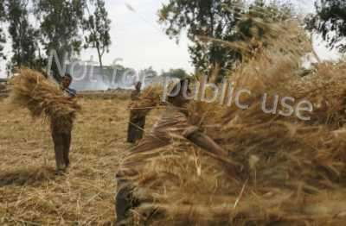
Baba
Drain water from your fields.
In the middle of the month, cultivate your early-ripening crops, then your late crops.
Harvest rice, and press oil from myrtle and nenuphar.
The Nile rises to its height

Slide 7
Hatur
The third month of the Coptic Agricultural Calendar
28 October-26 November

Slide 8
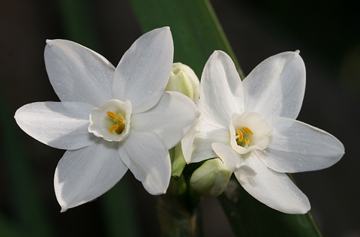
During Hatur…
Helpful Tips:
On the 7th, drain water from the fields for flax.
In the middle of the month, sow and fertilize seeds, and check your tools for pressing sugar cane.
It is the season for wallflowers, violet, narcissus, and horseradish!

Slide 9
Kihak
The fourth month of the Coptic Agricultural Calendar
27 November-26 December

Slide 10
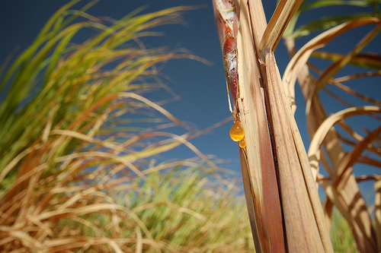
During Kihak…
On the 17th, mark the start of winter and sow trefoil.
Harvest and press sugarcane in its second year.
Harvest narcissus, citrus, green broad beans, carrots, and white leeks.

Slide 11
Tuba
The fifth month of the Coptic Agricultural
Calendar
27 December-25 January

Slide 12
On the 11th of Tuba…
Celebrate
Id al-Ghitas
and commemorate the sacred events of Christ’s baptism and union with the Holy Spirit!
Submerse yourself in the Nile, light a fire, and engage in public revelry!
Even if the Muslims don’t celebrate anymore, you can still enjoy your private Coptic feast!
It’s also close to the Winter Solstice!

Slide 13
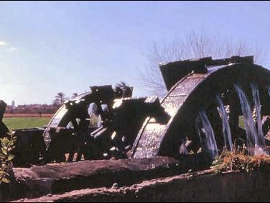
Also during Tuba…
Pick weeds, wild mustard, and thorn.
-Break and smooth irrigation disks.
-Set up water wheels (saqiya) for the cultivation of sugar.
-Do NOT sell oxen.
Complete the first plowing for summer crops like runner crops, cotton, and sesame.

Slide 14
Amshir
The sixth month of the Coptic Agricultural Calendar
26 January-24 February
***Taxes and Administrative Concerns***
Pick turnips and pay the appropriate land tax (kharaj) from them.

Slide 15
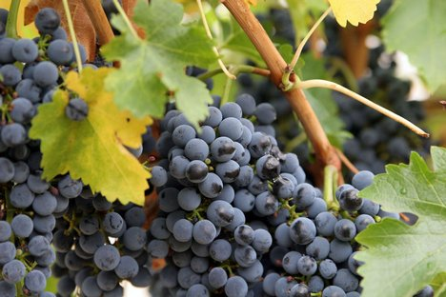
During Amshir
-Complete the second plowing for cultivation of summer crops; do another one just in case.
-Begin cultivating summer crops.
-Make tools for breaking irrigation dikes.
-Harvest grapes, almonds, and lotus fruit.

Slide 16
Barmahat
The seventh month of the Coptic Agricultural Calendar
25 February-26 March

Slide 17
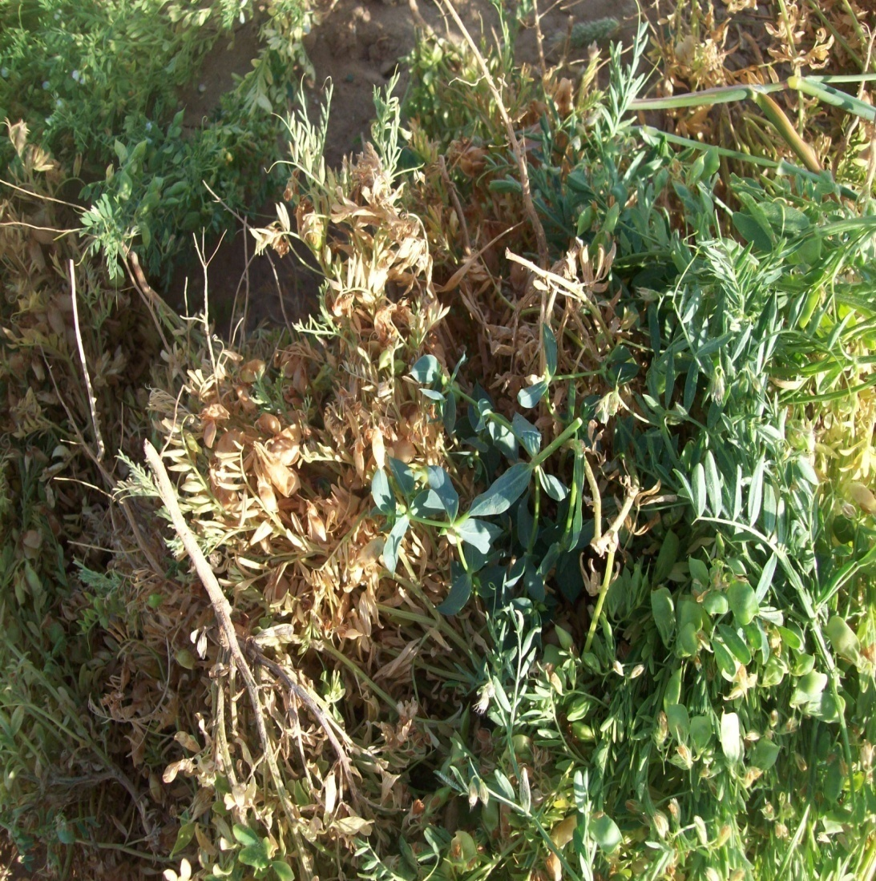
In Barmahat…
Celebrate the beginning of Spring on the 17th.
-Cultivate summer crops
-Harvest broad beans and lentils
-Pick flax
-Plant sugar cane in a fertile field that has not been cultivated for several years.

Slide 18
barmuda
The eighth month of the Coptic Agricultural Calendar
27 March-25 April

Slide 19
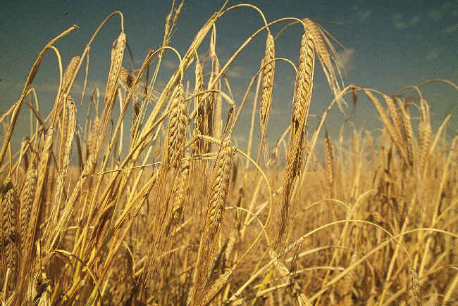
In Barmuda…
-Harvest broad beans and barley
-Gather cereals and thresh flax seeds.
-Make sure to cut down sant trees and carry them to the shore at al-Fustat through the Nile.

Slide 20
bashnas
The ninth month of the Coptic Agricultural Calendar
26 April-25 May

Slide 21
On the 8th of Bashans…
Celebrate
Id al-Shahid
the Festival of the Martyr which marks the beginning of Spring!
The martyr has come to represent the yolk of your people under the oppressive rule of the Muslims.
Gather with thousands on the shores of the Nile to watch as the priests remove the finger of the martyr from a box and wash it in the River to ensure the annual increase of the Nile!
Drink lots of wine– even the Mamluks don’t mind, since the liquor tax supports them!

Slide 22
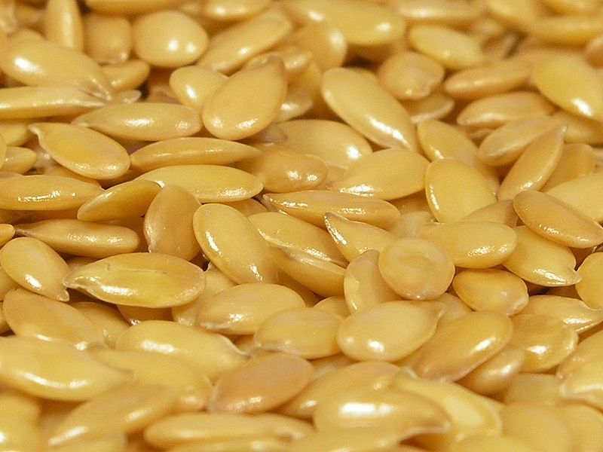
Also in Bashans…
-Sow rice and sesame, thresh crops.
-Sort seeds of flax, some of which should be separated for sowing.
-Irrigate balsam after sowing, preferably at the beginning of the month during the moist days.

Slide 23
Ba’una
The tenth month of the Coptic agricultural calendar
26 May-24 June
***Taxes and Administrative Concerns***
A surveyor will estimate your grape crop and then levy a land tax (kharaj) accordingly.

Slide 24
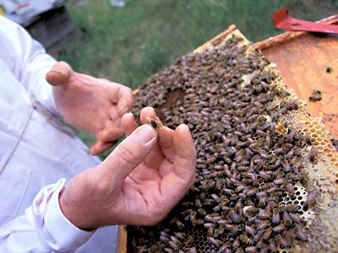
In Ba’una…
-Gather honey.
-Soak flax in water and turn it over four times during the months of Ba’una and Abib.
-Cultivate indigo (if you live in Upper Egypt) and harvest it after 100 days.

Slide 25
abib
The twelfth month of the Coptic agricultural calendar
25 June-24 July

Slide 26
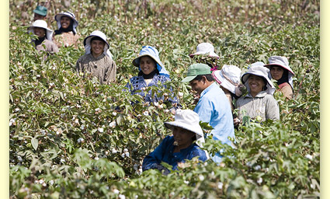
In Abib…
Take flax out of the water and expose it to the sun.

Slide 27
Misra
The thirteenth month of the Coptic agricultural calendar
25 July-23 August

Slide 28
In the middle of the Month…
Celebrate
Wafa al-Nil,
when the Nile reaches 16 cubit meters!
Well…as a Christian you might want to avoid this festival.
Although it was originally a Coptic festival celebrating the cycle of the Nile, the sultans have co-opted it: it now features Koranic recitations, and all of the notable Muslim leaders attend.
This is not to say that the Mamluk leaders encourage it: they avoid popular celebrations as much as possible.

Slide 29
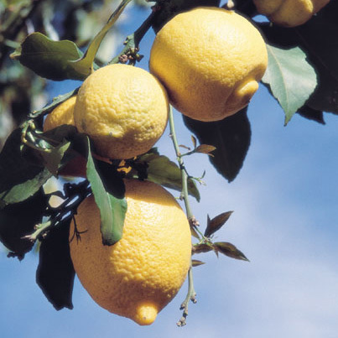
Also in Misra…
-Harvest unripe dates.
Harvest lemons.
Remember, the taste of fruit differs according to how it has been irrigated.

